Slide 1
Project presentation on:-
RATINGS PREDICTION PROJECT
Submitted by : Prerna Jain

Slide 2
Table Of Contents :-
Acknowledgement
Introduction
Problem Statement and understanding
EDA steps and Visualization
Steps and assumptions used to complete the project
Data Pre-processing Done
Set of assumptions related to the problem under consideration
Model Dashboard
Finalized Model
Conclusion

Slide 3
Acknowledgement
The internship opportunity I have with Flip Robo Technologies is a great chance for learning and professional development. I perceive this opportunity as a big milestone in my career development. I will strive to use gained skills acknowledge in the best possible way.
I would like to extend my appreciation and thanks for the mentors from Data Trained and professionals from FlipRoboTechnologies who had extended their help and support.
References: www.scipy.org, Kaggle, Github

Slide 4
INTRODUCTION
Problem statement and understanding
We have a client who has a website where people write different reviews for technical products. Now they are adding a new feature to their website
i.e. The reviewer will have to add stars(rating) as well with the review. The rating is out 5 stars and it only has 5 options available 1 star, 2 stars, 3 stars, 4 stars, 5 stars. Now they want to predict ratings for the reviews which were written in the past and they don’t have ratings. So, we have to build an application which can predict the rating by seeing the review.

Slide 5
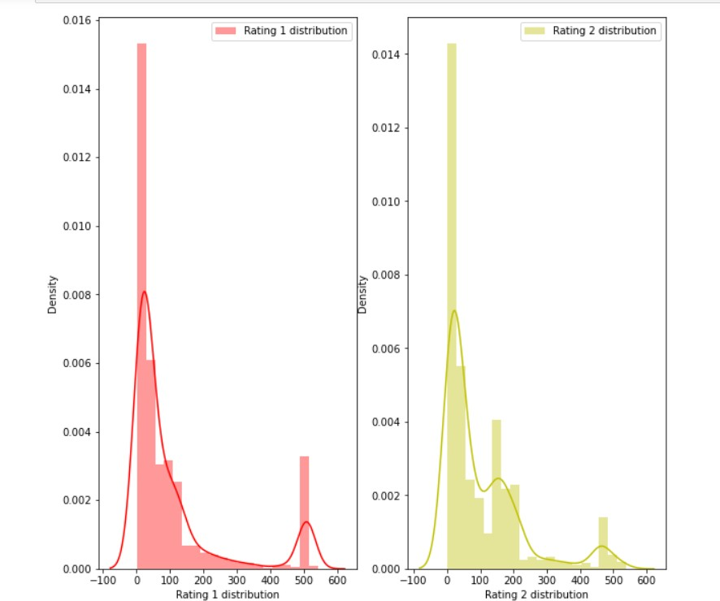
EDA steps and Visualization
Rating 1 and Rating 2 distribution after cleaning the reviews

Slide 6
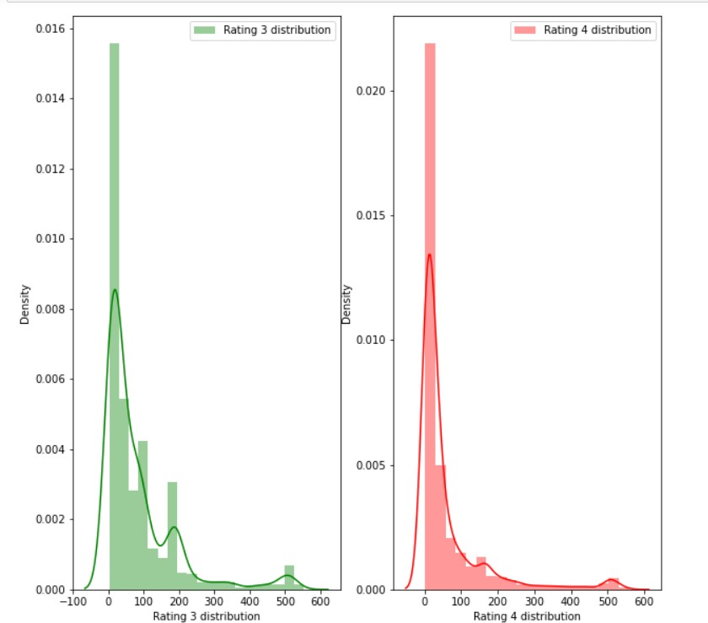
Rating 3 and Rating 4 distribution after cleaning the reviews:

Slide 7
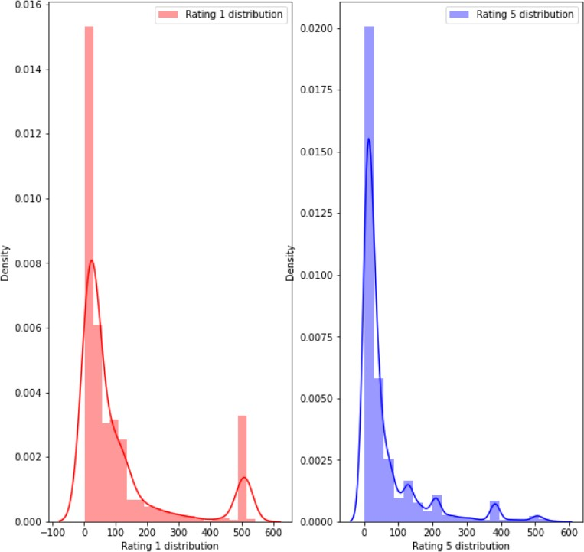
Rating 1 and Rating 5 distribution after cleaning reviews:

Slide 8
Data Preprocessing Done
We first looked for the null values present in the dataset. We noticed that there were no null values present in our dataset. Then we performed text processing. Data usually comes from a variety
of sources and often in different formats. For
For this reason, transforming your raw data is essential. However,
this is not a simple process, as text data often contain redundant and repetitive words. This means that processing the text data is the first step in our solution. The fundamental steps involved in
text preprocessing is, Cleaning the raw data Tokenizing the cleaned data.

Slide 9
Pre-processing involved the following steps:
Removing Punctuations and other special characters
Removing Stop Words
Stemming and Lemmatizing
Applying tfidf Vectorizer
Balancing the dataset through smote technique

Slide 10
Some very large length comments can be seen, in our dataset. These pose serious problems like adding excessively more words to the training dataset, causing training time to increase and accuracy to decrease! Hence, a threshold of 400 characters will be created and only comments which have lengths smaller than 400 will be used further.
Hence, after removing comments longer than 400 characters, we are still left with 16100 comments, which seems enough for training purposes.

Slide 11
Set of assumptions related to the problem under consideration
By looking into the target variable label we assumed that it was a Multiclass classification type of problem.
We observed that the dataset was imbalanced so we will have to balance thedataset for a better outcome.

Slide 12
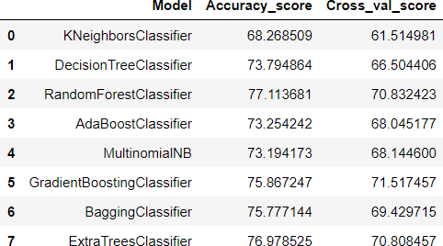
Model Dashboard
We observe that the Random forest classifier is giving is best resultsso we save it as our final model.

Slide 13
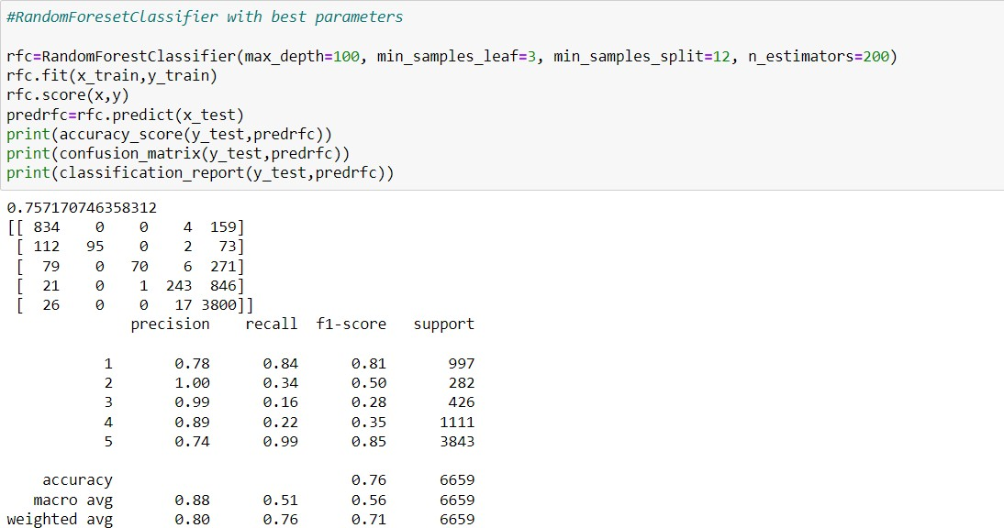
Finalized Model
We interpreted that Random forest classifier model was giving us the best results with an accuracy score of 75.71 and a comparatively betterf1-score so we saved it as our final model.

Slide 14
Conclusion
In this project we have tried to detect the Ratings in commercial websites on a scale of 1 to 5 on the basis of the reviews given by the users. We made use of natural language processing and machine learning algorithms in order to do so. We interpreted that Random forest classifier model is giving us best results.
Learning Outcomes of the Study in respect of Data Science
Data cleaning was a very important step in removing null values from the dataset.
Visualising data helped identify class composition of label column and the most frequently occurring words in reviews corresponding to each of the rating scores.

Slide 15
The various data pre-processing and feature engineering steps in the project lent cognizance to various efficient methods for processing textual data. The NLTK suite is very useful in pre- processing text-based data and building classification models.
Limitations of this work and Scope for Future Work
A small dataset to work with posed a challenge in building highly accurate models. By training the models on more diverse data sets, longer comments, and a more balanced dataset, more accurate and efficient classification models can be built.

